Slide 1


Using FairSplit to Modernize How Divorcing Couples Deal with and Divide Personal Property

Slide 2
This presentation, and any accompanying materials (including any chat or Q&A-related communications), are for informational purposes only and are not intended to provide, nor should they be relied upon as, legal advice.
Disclaimer

Slide 3

David MacMahan is the founder and president of FairSplit.com “Divide Things, Not Families”, long time entrepreneur and someone who challenges status quo. Over the past fifteen years of working with families and divorcing couples dividing estates, he is now widely recognized as the leading industry expert on estate division of personal property. He has personally helped navigate the family dynamics in thousands of those divisions, and helping all involved understand the places the parties are coming from, and how to accommodate in unique family situations. He is often hired to serve as Administrator of the FairSplit process, but also as an independent third-party mediator to help keep tensions down between family members and reduce the pressure on executors of the estate.

Slide 4

Recurring Challenges Seen When Dividing Personal Property
You Can’t Divide What Isn’t Clearly Listed
Comprehensive Inventory first, decisions second
Most conflict around the “things” stems from incomplete or unclear lists, or inflated or minimized values
Hidden, forgotten, overvalued or undervalued items derail negotiations
Photos + AI listing dramatically reduce time required and avoids omissions
A shared, real-time list eliminates “he said / she said”
Notes:
These can all be addressed in the trust documents and avoided. If not stated, heirs’ assumptions are different…. What Mom would have wanted….. Not the same

Slide 5
Why Online is Usually The
Better Way to Divide
Assets and debts are part of the same equation
While FairSplit typically is referencing personal property assets, any liabilities may simply be entered as negative values to help create a full, true picture.
- Credit cards, loans, tax liabilities often overlooked initially
- Responsibility for debt can be more contentious than assets
- Must be tracked alongside assets for true net division
- Impacts equalization calculations

Slide 6
Co-Brand and Provide as a Client Tool
50% OFF $300 set-up – NADP-cobrand50 5-minute set-up
https://www.fairsplit.com/co-brand/
NADP Landing Page: https://www.fairsplit.com/plp/nadp/
Upload logo and contact footer copy
All reports and pages are your company brand and unlimited Ai inventory accounts included.
$150 per year renewal for unlimited use

Slide 7
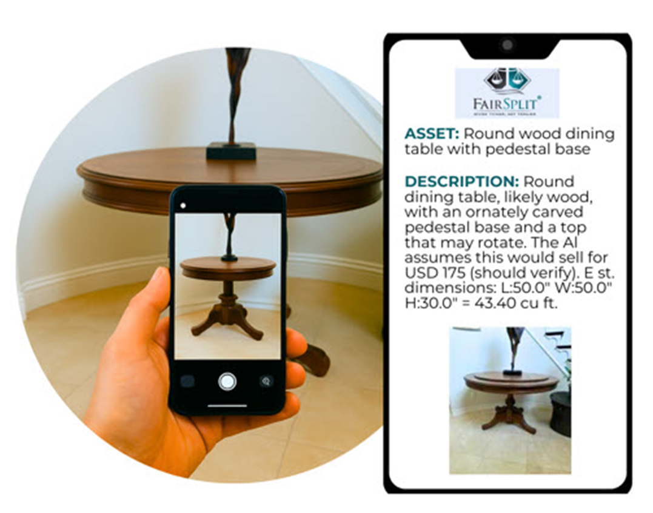
Get The Assets Listed -
AI Reduces the Task by Tens of Hours
What once took many tens of hours to photograph, type up in spreadsheets, insert Dropbox links to photos and email to all heirs, is now done with AI in hours, not weeks.
1. Photograph as one would want to choose
2. Upload room by room
3. Submit to AI
4. Go to next room and repeat
5. Double check report for any errors and correct

Slide 8
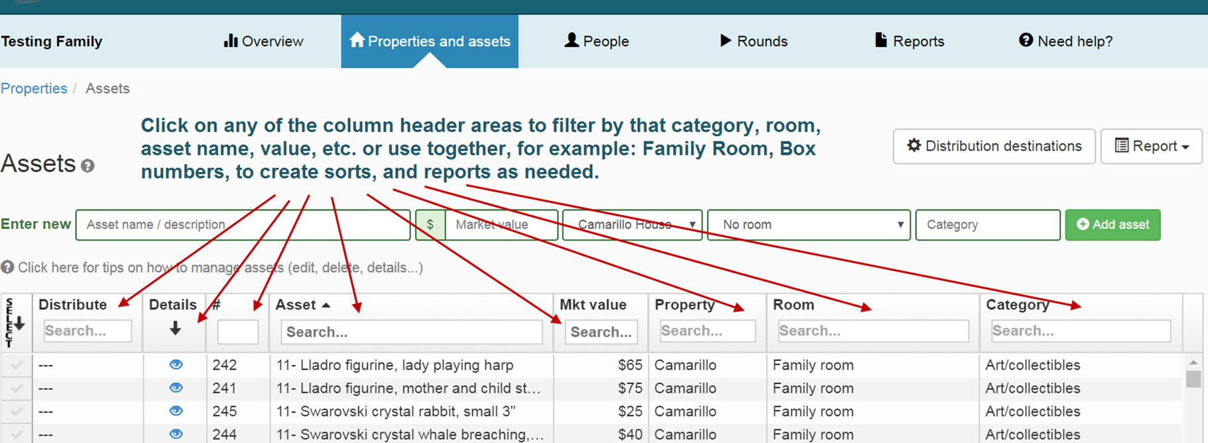
Heirs Have Access Online

Slide 9
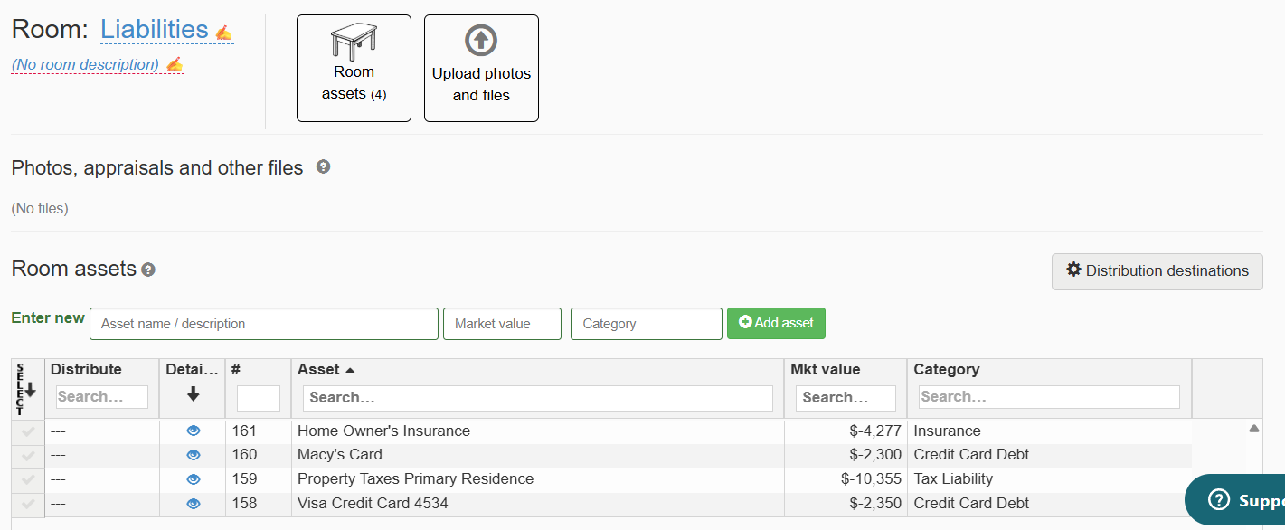
Create a Liabilities Room

Slide 10
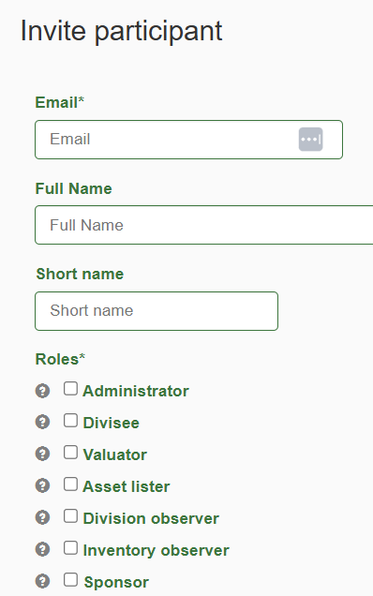
Role Permissions Vary
All can be invited with different permissions: the divorcing parties, attorneys, mediator, move managers, to streamline the overall settlement with everyone seeing the same thing in real time.

Slide 11
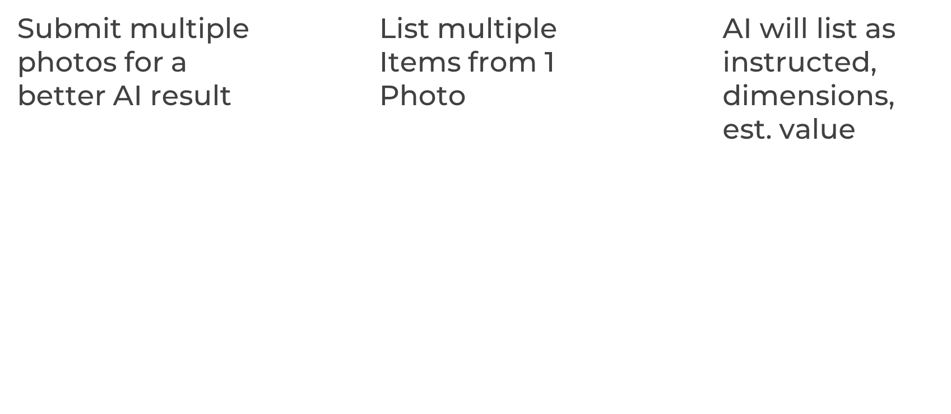
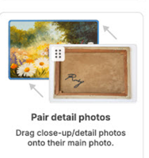
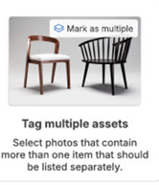
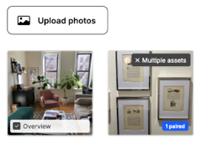
Getting it all listed can be the most overwhelming task. (easy now; easier soon)

Slide 12
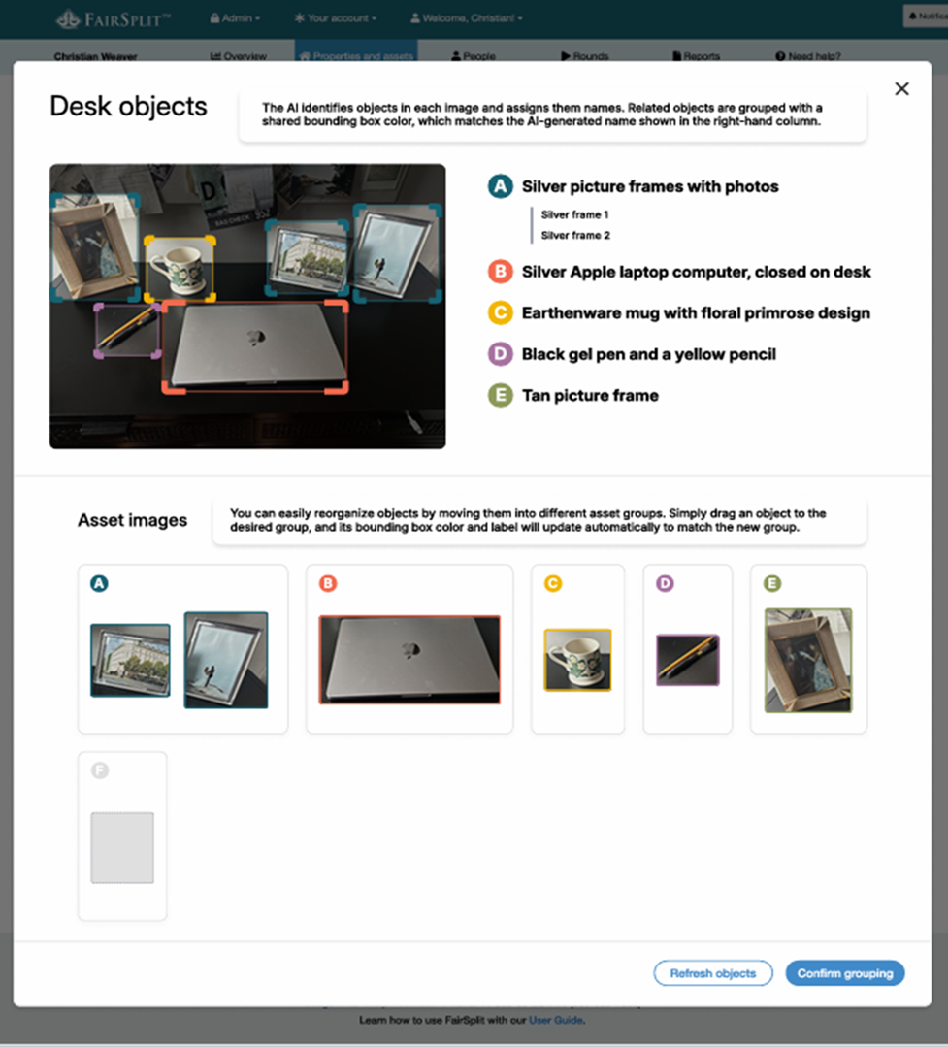
e to name each item separately when identified as a multi-item image. The accuracy is increasing to where we expect a half dozen photos taken in most rooms will get everything in the room listed accurately. This includes dimensions, est. market values and links to recently sold online
AI will be able to name each item separately when identified as a multi-item image. The accuracy is increasing to where we expect a half dozen photos taken in most rooms will get everything in the room listed accurately. This includes dimensions, est. market values and links to recently sold online

Slide 13
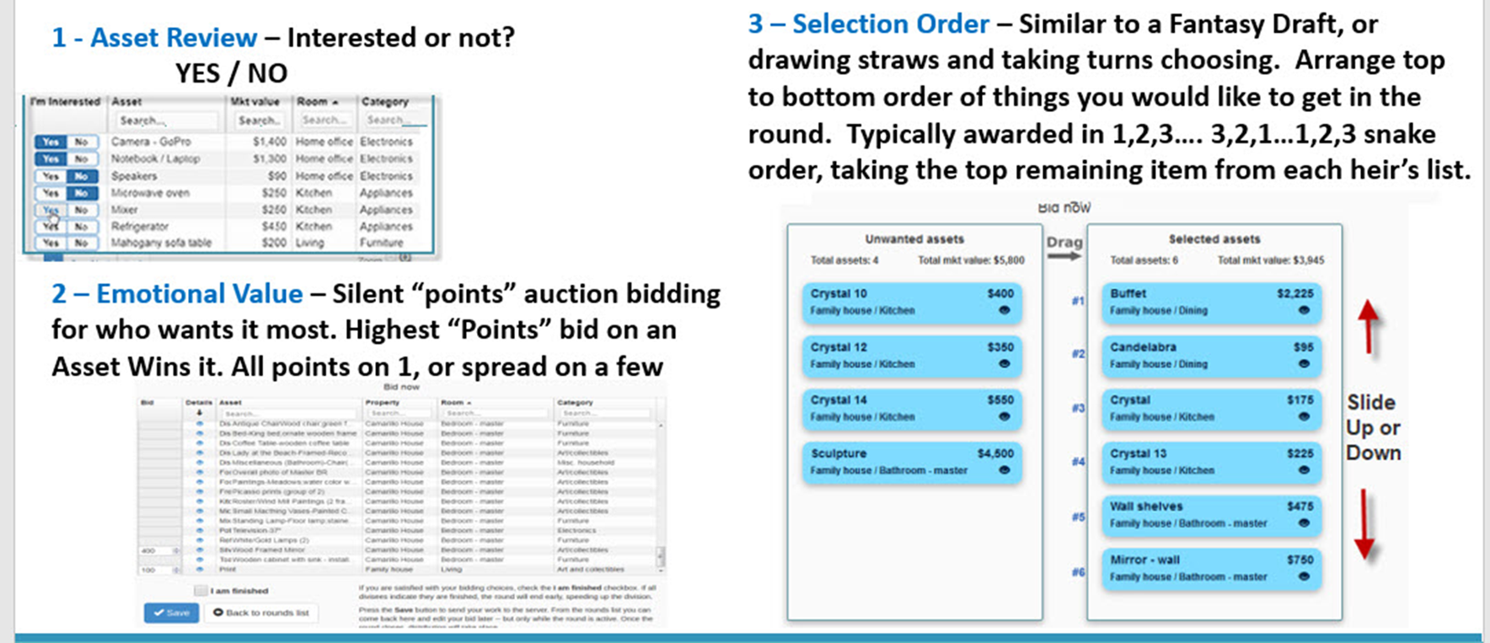
Online access to a proven system of rounds, allows each party to login, and participate in a blind fair system at their convenience. Often the Selection Order Rounds are all that is needed.

Slide 14
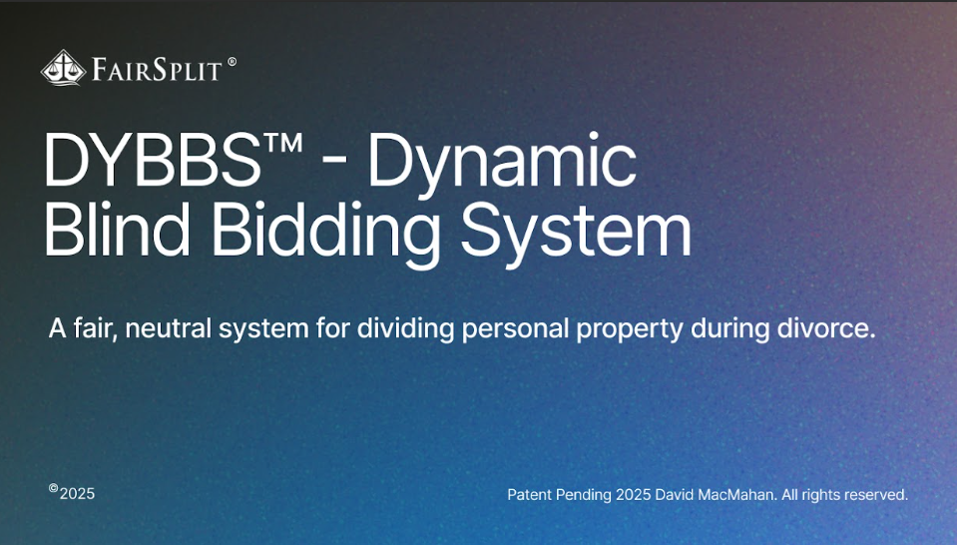

Slide 15
DYBBStm – Dynamic Blind Bidding System
Coming Summer 2026
Parties rank their preferences top to bottom
Assign points to indicate weighted interest
System awards top points item to winner
Charges 1 point more than the 2nd place bid
All listed things can be dealt with in a single round
Can also be used for alternating selection, not using points – 1,2,1,2,1,2,1.2… top item remaining on each list
Patent pending
Notes:
We want to invite you to be EVOLUTIONARIES …. EVOLVE AND USE NEW TOOLS REVOLUTIONIZE AND IMPROVE YOUR CLIENT FAMILIES’S EXPERIENCE

Slide 16
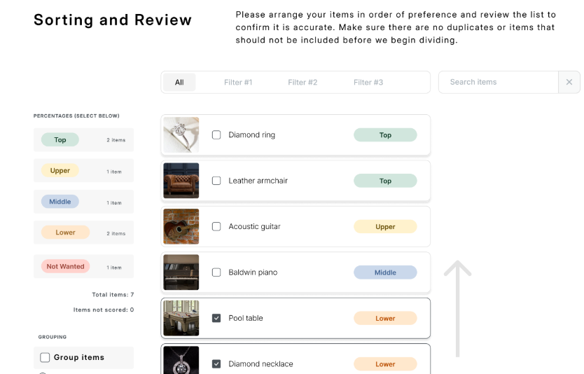

Slide 17
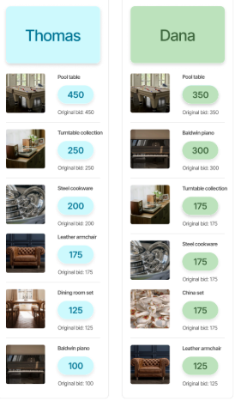
After arranging in top to bottom order, both parties are given the same number of points to distribute, weighting the things, so their ranked preferences have more accurate indicators of interest.

Slide 18
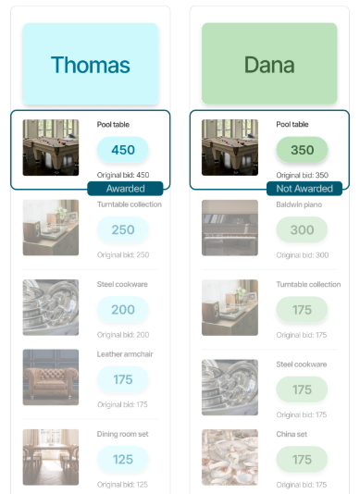
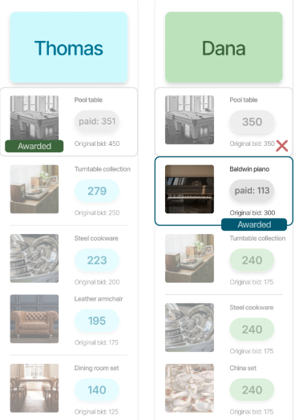

Slide 19
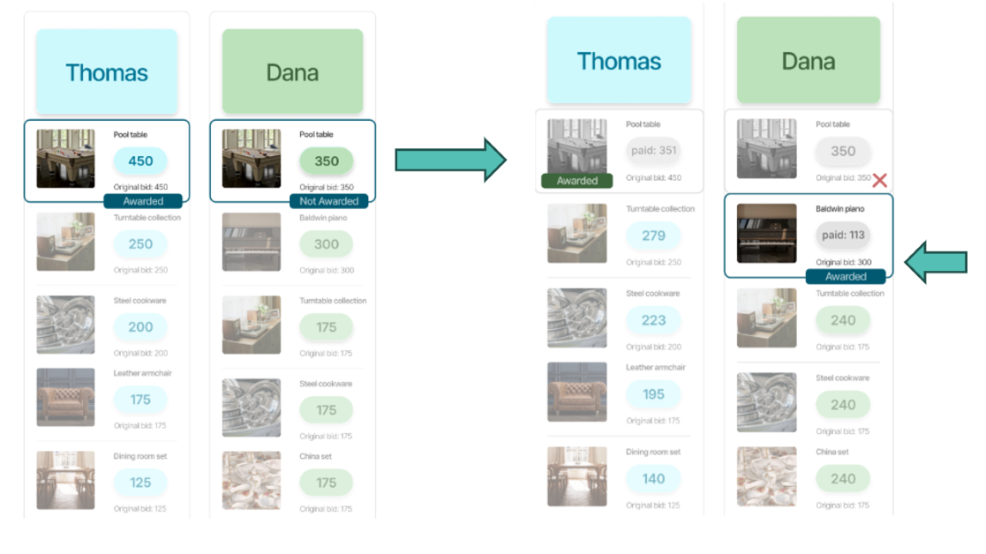
With DYBBS, No Points Are Lost - Win or Lose, Points Flow to the Next Most Wanted Item

Slide 20
Why Online is Usually The
Better Way to Divide
- Participation: online access less schedule dependent
- Neutrality: Level playing field, consistency (Algorithm has no bias)
- Relationship Ethics: No “in person triggers”, no bias or judgement in an online process – 3rd party guidance is usually helpful
- Information: A single source of accurate, complete, transparent, easily corrected, information aids both the professionals helping and the couple

Slide 21
Best Practices for Planning of Personal Property
Even when anticipating a potential divorce:
Having a comprehensive list of personal property / assets is good.
Covers worst cases: Coming home to an empty house, or things mysteriously disappearing is hard to reconcile without a starting inventory
Be sure to indicate pre-marital assets

Slide 22
Remember, You Are Their Guide
Unstructured negotiation leads to conflict loops.
Arguing item-by-item is inefficient and emotionally draining
Structured processes (rounds, blind bidding, prioritization) depersonalize decisions
Removes direct confrontation over individual items
Encourages progress instead of stalemate
Notes:
We want to invite you to be EVOLUTIONARIES …. EVOLVE AND USE NEW TOOLS REVOLUTIONIZE AND IMPROVE YOUR CLIENT FAMILIES’S EXPERIENCE

Slide 23
DYBBStm – Dynamic Blind Bidding System
Coming in 2026
All unused points flow to the winner’s other remaining items proportionally
Losing bidder’s points also flow to their remaining available items
No points wasted
True preferences flow, repeats until all things are awarded
Patent pending
Notes:
We want to invite you to be EVOLUTIONARIES …. EVOLVE AND USE NEW TOOLS REVOLUTIONIZE AND IMPROVE YOUR CLIENT FAMILIES’S EXPERIENCE

Slide 24
Contact Information
David MacMahan
David@FairSplit.com
855-58ESTATe
(855-583-7828
NADP Page: https://www.fairsplit.com/plp/nadp/

